Slide 1
CS 383 Team Lead 3
Quality Assurance and Patterns
Tosin Bangudu, Kyle Hash, Liam Mathews

Slide 2
Presentation Outline
Introduction:
What is testing
Why is it important
Types of testing
Unit Testing
Writing testable code
Edit vs Play mode tests
Setting up testing (assemblies)
Boundary Tests
Creating Boundary Tests
Executing tests

Slide 3
What is Testing?
Testing is intended to show that a program does what it is meant to and to catch defects before it’s release.
Testing is executing a program with artificial data
This is a part of software validation and the verification process
Testing can reveal the presence of errors but not their absence
Results of a test can be checked for information on errors and non-functional aspects of the program

Slide 4
Why is Testing Important?
Testing allows us to find situations in which the software operators incorrectly, and it enables us to validate that the software meets its requirements.
Validation:
Shows that the system is operating as intended from design and implementation
Operates correctly under a set of test conditions

Slide 5
Types of Testing
There are several different types of software testing:
System Testing:
Use-case testing
Release Testing
User Testing:
Alpha
Beta
Acceptance
Requirement Based Testing
Performance Testing
Stress testing

Slide 6
System Testing
System testing is the testing of a fully integrated and complete piece of software
Use-case testing is a basis for system testing:
Use cases are used to identify the interaction of the system
These interaction between system components are then tested

Slide 7
Release Testing
Release testing is a form of system testing
There are some key difference between the two:
A separate team not involved in development is responsible for release testing
System testing should be focused on discovering bugs
Release testing should check whether a system meets its requirements and is ready for validation testing

Slide 8
User Testing
User testing is a type of testing in which the customers/users provide input on system testing.
It is essential to conduct even after release and system testing because the user’s environment can’t be reproduced in a testing environment.
Alpha
Users work with the dev team to test the software at the developer’s site
Beta
A release of the software is made available to users to allow them to experiment and find problems with the system
Acceptance
Customers test a system to decide whether or not it is ready to be accepted from the developers

Slide 9
Requirement Based Testing
Involves examining each requirement of a system and designing a specific test(or tests) for that requirement

Slide 10
Create Loosely Coupled Code
Code is easier to understand
Makes program more modular
Program is easier to change, update, and expand
More testable code
Basically, the connections between different parts of your code are not dependent on one another

Slide 11
Function Contents
One function should have only one function
Functions should be non-deterministic (different results)
Single Responsibility Principle
A function should either product or process information, not both.
If a function needs extra data, have it passed as a parameter
Inversion of Control
Separate decision making code and action code

Slide 12
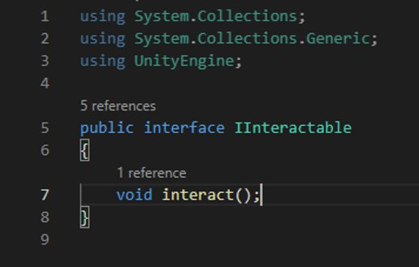
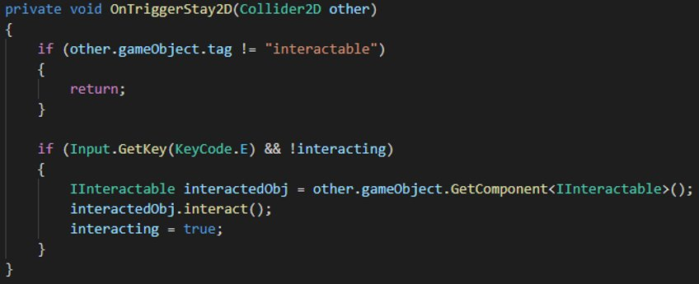
Interfaces
Useful tool for keeping code loosely coupled

Slide 13
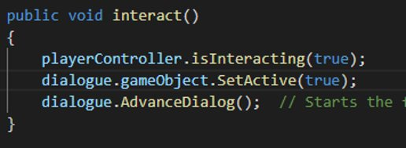
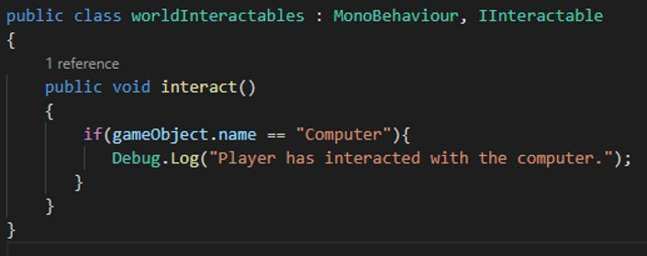
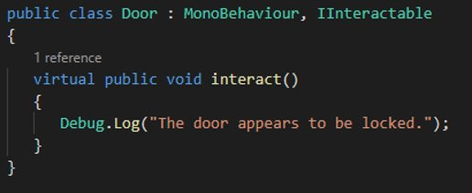
More Interfaces

Slide 14
Edit Mode Vs. Play Mode Tests
Edit mode:
Tests code that doesn’t require a running scene to test
More useful for calculation
Much faster to run
Play Mode:
Tests code that needs to be executed in a running scene
Tests are ran as coroutines
More useful for testing things like movement

Slide 15
What are Boundary Tests?
A boundary test is any sort of test that checks whether a value is within some specified range
These tests can check for if a value is within, on, or outside of a boundary

Slide 16
Creating Unit Boundary Tests
3 Main areas of a Unit Test:
Arrange
Act
Assert
A boundary test is a specific type of unit test
Tests to verify that edge cases are properly handled
Verify that unexpected behavior doesn’t occur if given unexpected values
Test cases:
Test just inside the boundary
Test on the boundary
Test just outside the boundary

Slide 17
Team Deliverables (End of Pres)
Thursday (10/6)
One Test Case to Demo /2
Initial Test Plan to Demo /10
Oral Exam
Full Test Plan /40
Patterns
Must implement 2 by Oral Exam /60

